Slide 1
Navigating a maze using Anki’s Cozmo
Maxwell James McMahon

Slide 2

Goal:
We wished to demonstrate maze-pathing algorithms in a visual and exciting manner. To achieve this end we used Anki’s Cozmo robot, along with its python-based SDK

Slide 3
Algorithms

Slide 4
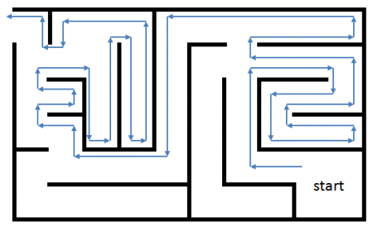
Wall Follower
Move alongside wall until maze is exited
Only works with simply-connected mazes
Mazes in which all walls are either connected to each other or the boundary

Slide 5
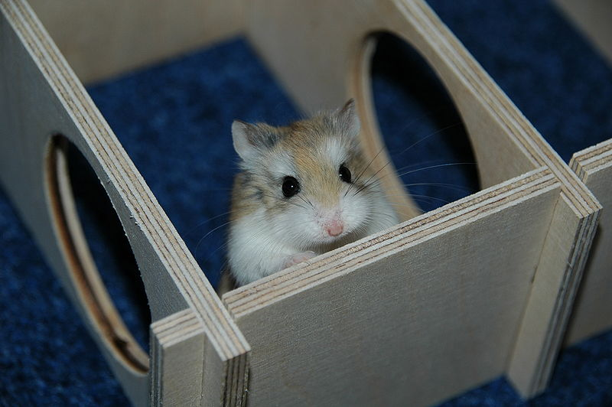
Random Mouse algorithm
When junction is encountered, head down a randomly chosen path
Continue until exit is reached
Simple, yet inefficient

Slide 6
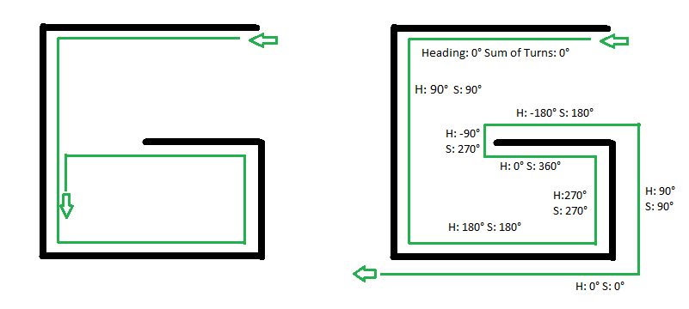
Pledge
Advance until obstacle is encountered
Place “hand” on wall
Change heading and number of turns after each turn
If heading and turns both=0 return to step 1
Otherwise, continue following wall
Compares a left-wall follower to pledge, heading wal

Slide 7
Tremaux’s algorithm
Mark each path once
Never enter a double marked path
At a new junction, choose arbitrarily path
If mark is encountered:
If entry path has less than two marks go back on your path
Otherwise, take the path with least marks

Slide 8
Implementation

Slide 9
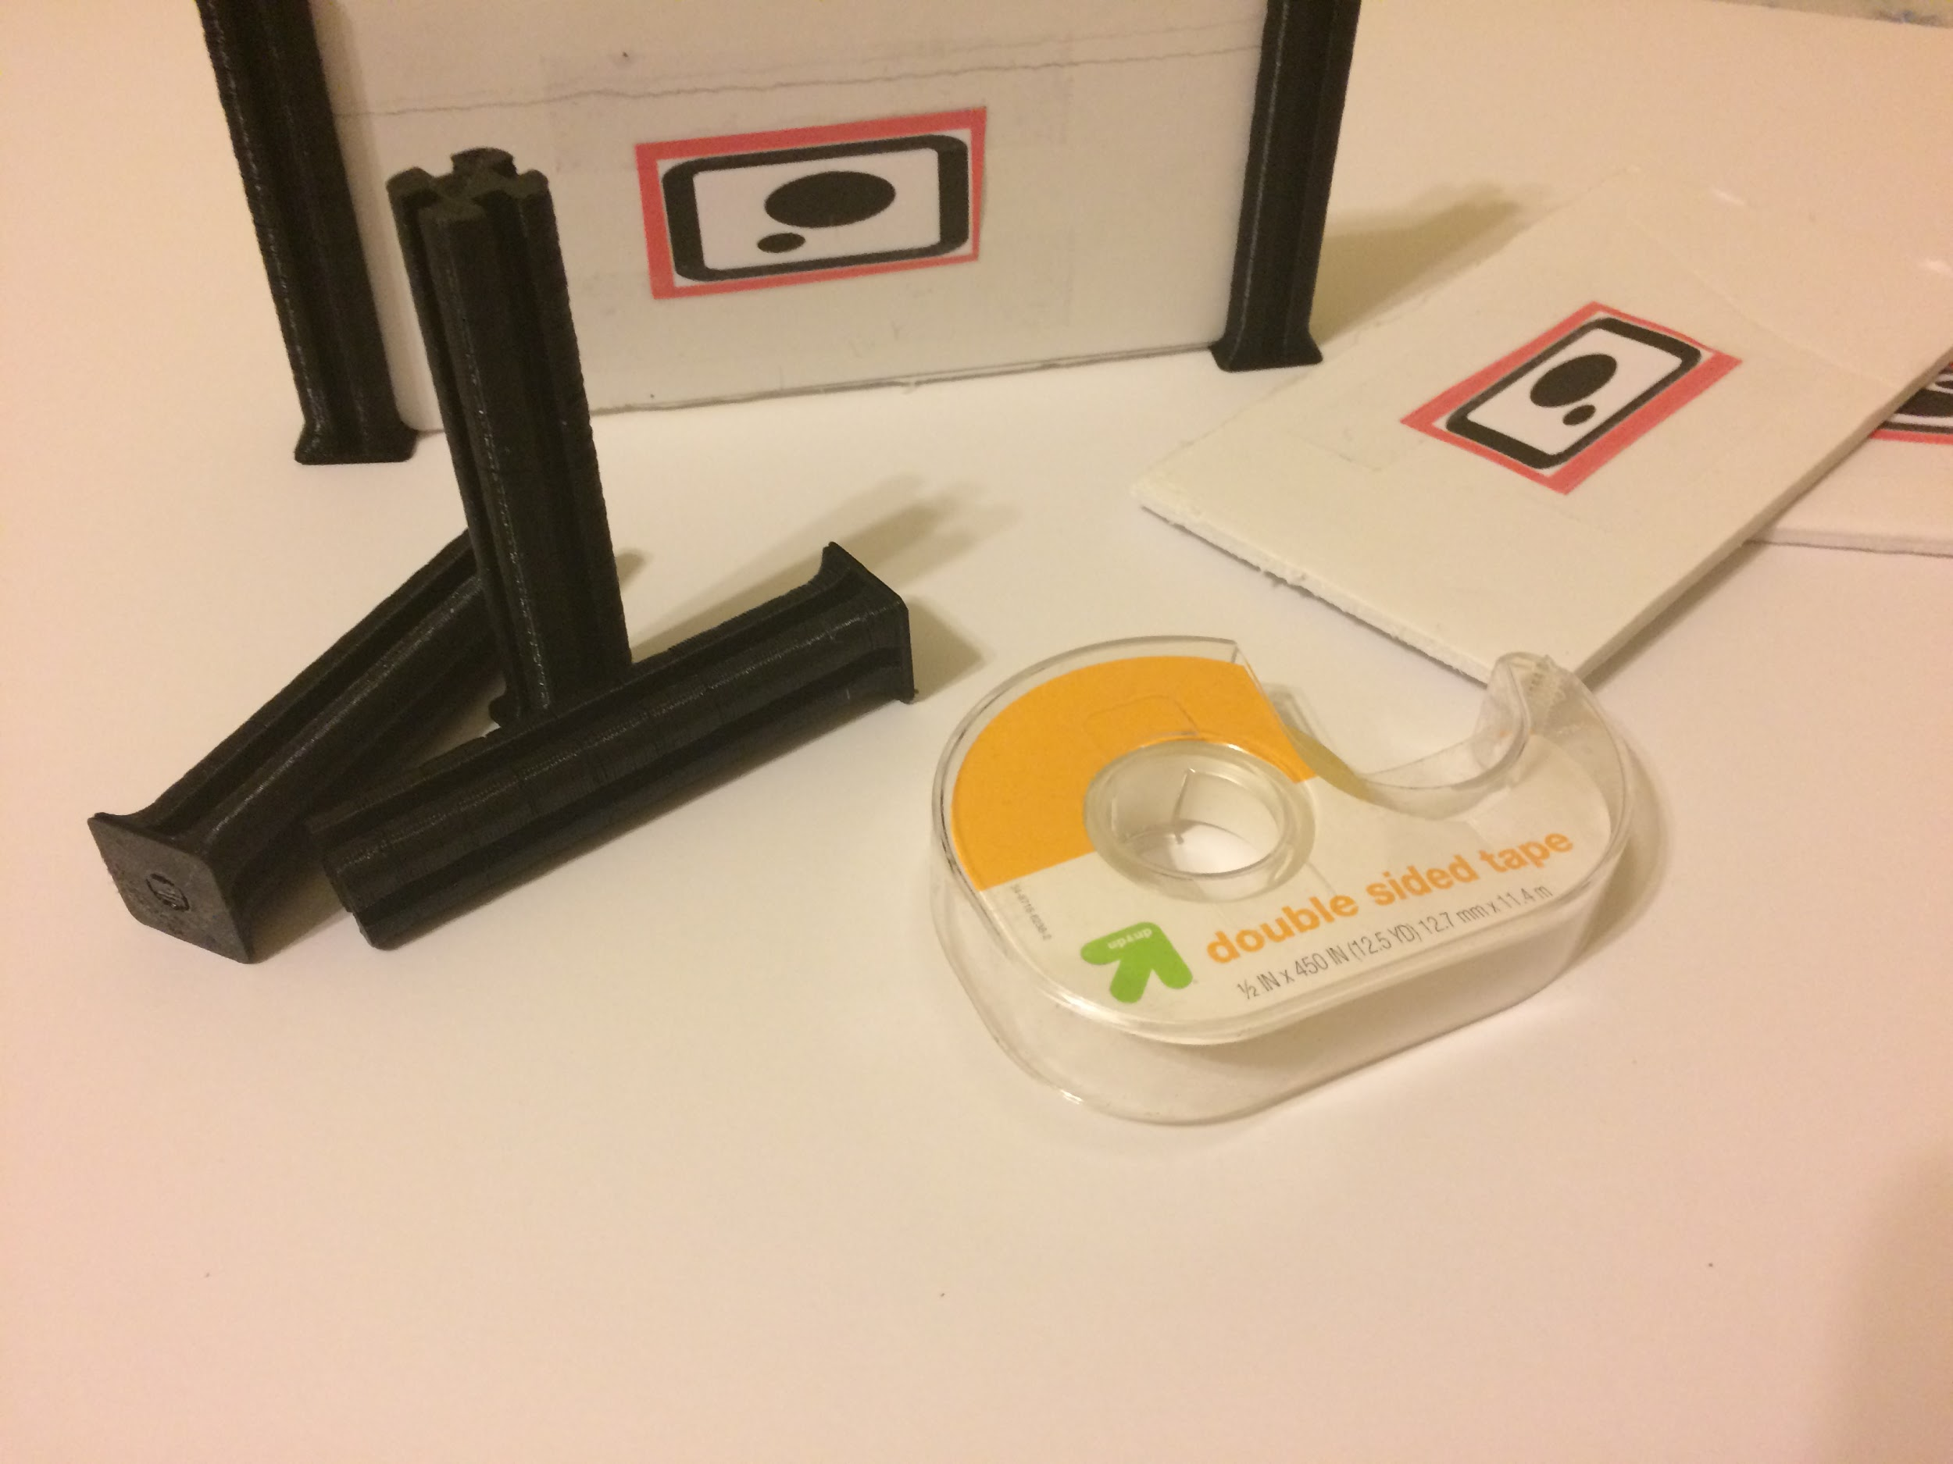
Maze Construction
The mazed is modular, and consists of a foam board base, foam board walls, and 3d printed corner pieces.
Walls are labeled with a marker image so that they are recognized by Cozmo
Some pillars are attached to board with sticky tape for increased stability

Slide 10
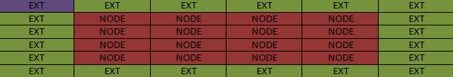
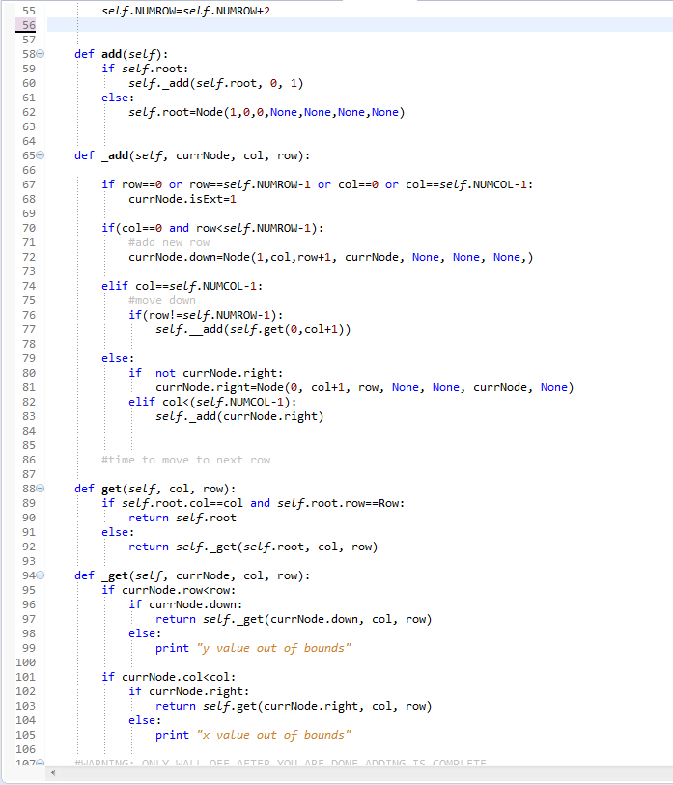
Maze Structure
Maze Class
Add: creates new node, pins to end of array
Get: returns a Node at a specific index
wallOff: severs connections between nodes (such as when a wall is found)
Not pictured
create : creates maze given number of columns and rows
Top: Maze Layout: Exts are exterior cells. The root at 0,0 is labeled in purple
Right: code for add and get methods of the Maze class

Slide 11
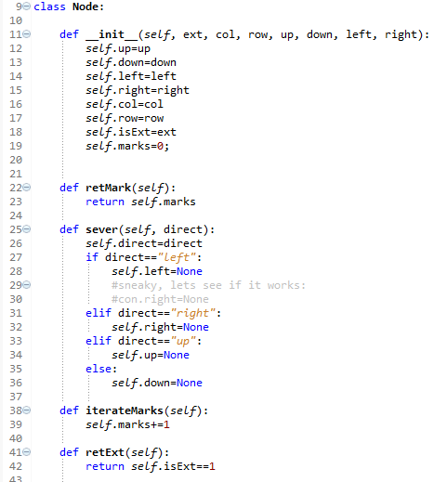
Maze Structure Cont.
Node:
retExt: returns whether or not a node is an exterior piece
retMarks: return Mark Count
iterateMarks: increases mark Count
isJunct: if a Node is a junction piece: (>=3 exits) this is set to 1, if not, set to -1,

Slide 12
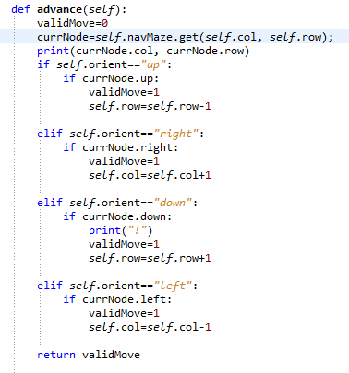
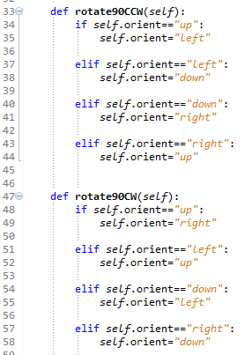
Navigation Structure
NavStat Class:
getOrient: returns orientation
getRow: returns current row
getCol: returns current column
rotate90CW and rotate 90CCW: determines orientation of robot after a 90 degree clockwise/ counterclockwise turn
Advance:moves forward based on orientation, returns whether movement is valid
Retreat: Moves backward based on Movement, returns if movement is valid
Left: rotate code
Right: advance Code

Slide 13
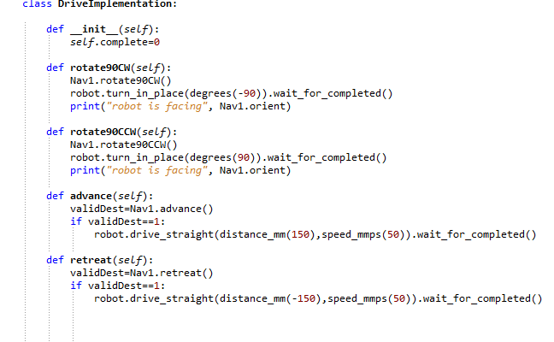
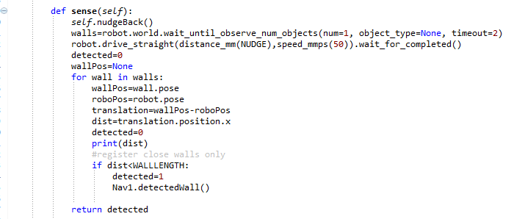
Navigation Movement
DriveImplementaion Inner Class (required b/c oddities of SDK)
rotate90CW: performs NavStat rotate90CW, and rotates robot 90 degrees CW
Rotate 90CCW: Reverse of rotate 90CW
Advance: performs NavStat advance, and moves robot forward if movement is valid (no wall)
Retreat: reverse of advance
Sense: uses camera to determine if there is a wall in front of cozmo, Cozmo Backs up to in order to see entire marker, returns 1 if wall is found, otherwise returns 0
Top: movement
Bottom: sensing

Slide 14
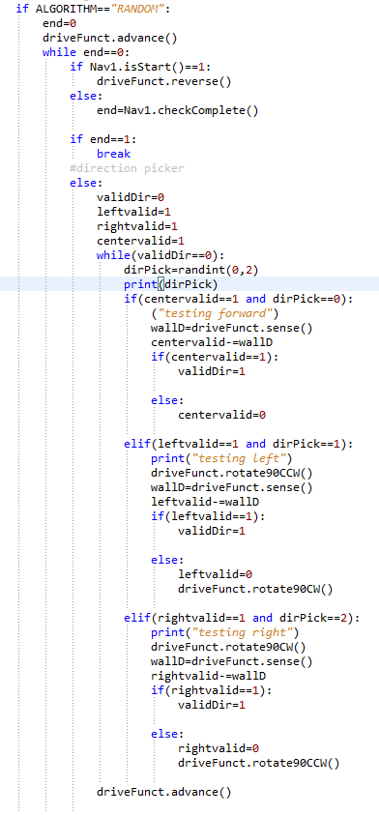
Algorithm implementation: Random Mouse
Surprisingly complex to implement!
Advance into maze
Outer loop: ends when exit is found
Check if maze is completed
Reset left, right, and center flags to 1
Inner Loop: ends when valid direction is picked:
Choose random number integer between 0 and 2
Select path based on result (0 for center, 1 for left, 2 for right
If chosen direction’s flag is 1 turn that direction
See if there is a wall, if there isn’t advance and exit inner loop. Otherwise, set that direction’s flag to 0
Random Path Code

Slide 15
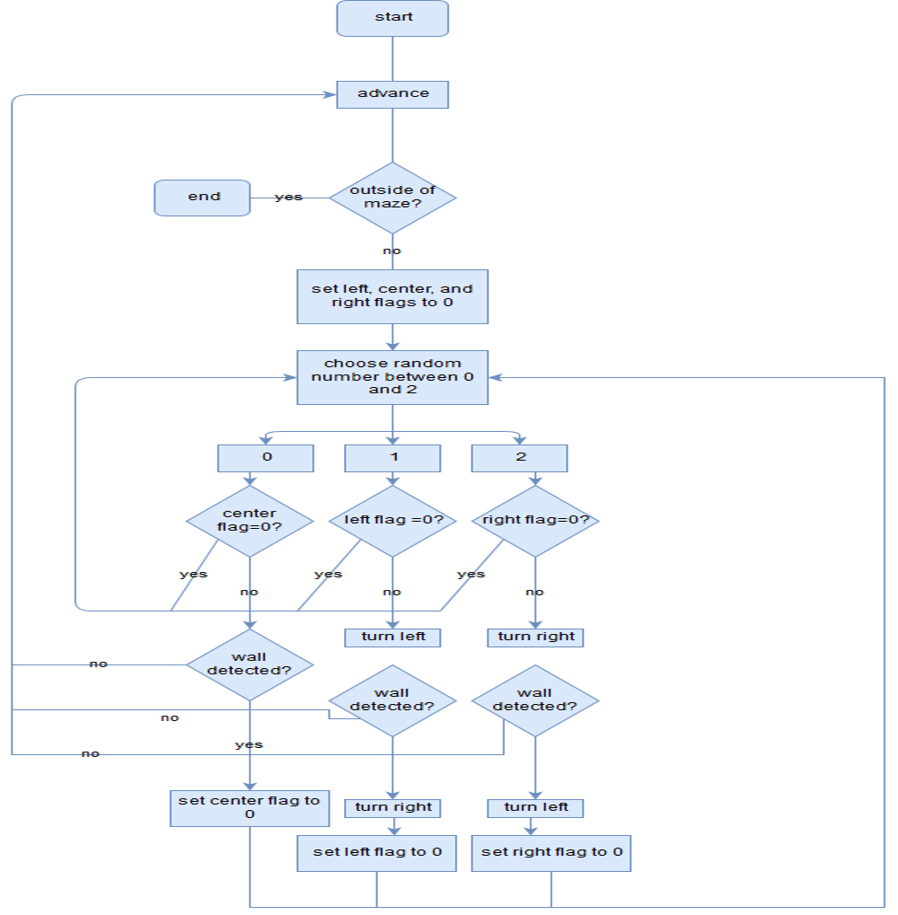
Random Mouse FlowChart

Slide 16
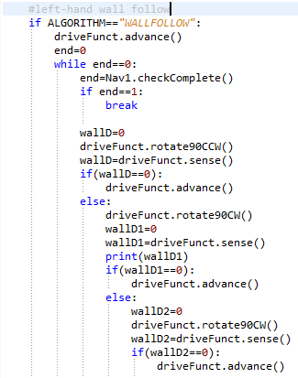
Algorithm implementation: wall follower
Left-hand wall Follow:
Advance into maze
Loop until maze is exited:
Rotate left and see if a wall is present, if there is not, move forward
If wall was detected in previous step, rotate right and check if there is a wall in front of robot, if there is not, move forward
Turn right and check if there is a wall in front of robot, if there is not, move forward.
Wall Follow Code

Slide 17
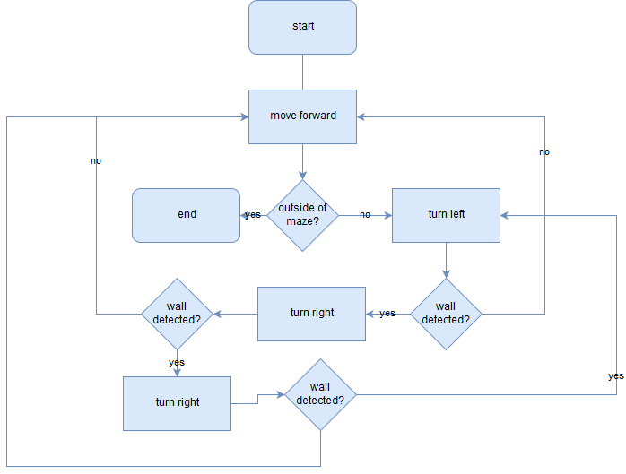
Wall Follower Flowchart
yes

Slide 18
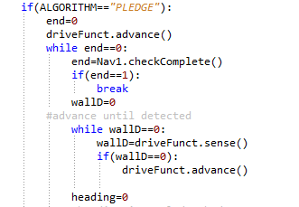
Algorithm Implementaion: Pledge
In a directly connected graph, pledge functions as a more complex wall-follower
Advance
OuterLoop perform until maze is exited
Detect Obstacle
If obstacle detected: set heading and turns to 0. Turn right and subtract 90 from heading and 1 from turns. perform Inner loop until heading and turns are equal to zero
Inner loop on next slide
Advance and check for completion
Pledge outer loop code

Slide 19
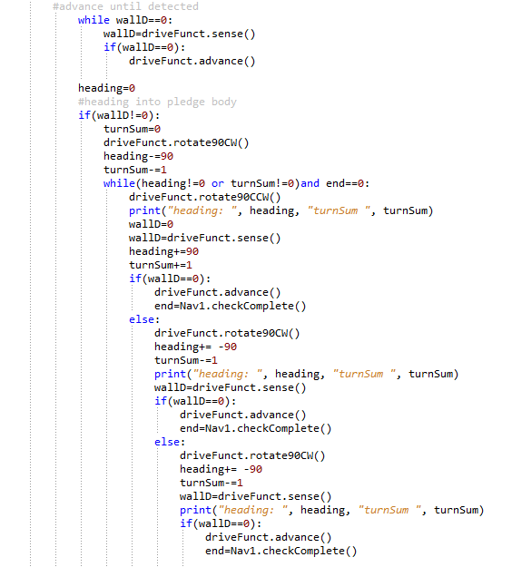
Algorithm Implementaion: Pledge (con’t)
Inner Loop: loop until heading=0 and turns=0
Turn left, increase turns by 1 and heading by 90. if there is no wall, advance
If there was a wall in 2, turn right, reducing heading by 90, and turn by 1, if there is no wall advance
If there was a wall in 3, perform 3 a second time
Pledge Inner loop code

Slide 20
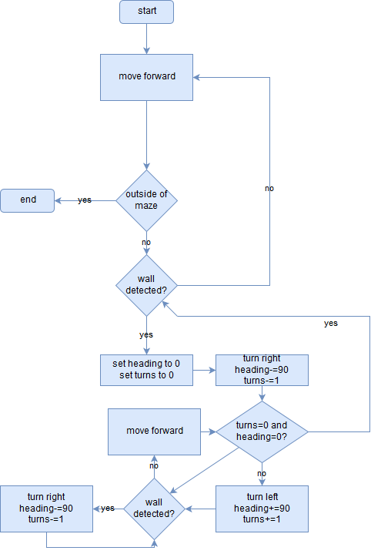
Pledge FlowChart

Slide 21
Demonstration

Slide 23
Future Work
Course correction
Increased size mazes
GUI for maze parameters
Following a line with cliff sensor for course correction

Slide 24
Thanks/Acknowledgments
Dr. Marietta Cameron: Faculty Advisor
Dr. Kenneth Bogart: 3d printing support
Hann Henson: 3d printing and modeling support
Dr. Adam Whitley: advisor
Makeblock forum user Chuck McKnight: pillar model

Slide 25
Image Credit
Maze animation created by wikimedia commons user Grj23, licensed under Attribution Share-Alike 4.0
Cozmo Images are property of Anki
Mouse Image created by wikimedia commons user Bullet, licensed under Attribution Share-Alike 3.0
Wall Follower Image:
Pledge Image: created by wikimedia commons user Randomperson321 licensed under Attribution Share-Alike 4.0 international
Flow Charts Made with draw.io

